Slide 1

Customer Shopping Behavior Analysis
End-to-End Data Analytics & Business Intelligence Project
Author: Sai Aman Teppala
amansaileo@gmail.com | LinkedIn | GitHub

Slide 2

Project Overview
Objective
Process
Skills Demonstrated
Analyze customer shopping behavior using a full end-to-end data analytics pipeline.
Clean, transform raw data, store in relational database, perform analytical queries, build interactive dashboard.
Python, PostgreSQL, SQL, Docker, Power BI, data visualization.

Slide 3

Problem Statement: Unlocking Insights
Businesses need to understand customer patterns for informed decisions.
1
Customer Segmentation
Identify most valuable customer segments.
2
Subscription Impact
Do subscribed customers spend more?
3
Product Performance
Which products and categories drive revenue?
4
Demographic Influence
How do age, gender, and shipping affect sales?

Slide 4

Technology Stack
Programming
Database
SQL Development
Python (Pandas, NumPy)
PostgreSQL 15, Docker
VS Code (SQLTools)
Visualization
Notebook
Power BI Desktop
Jupyter Notebook

Slide 5
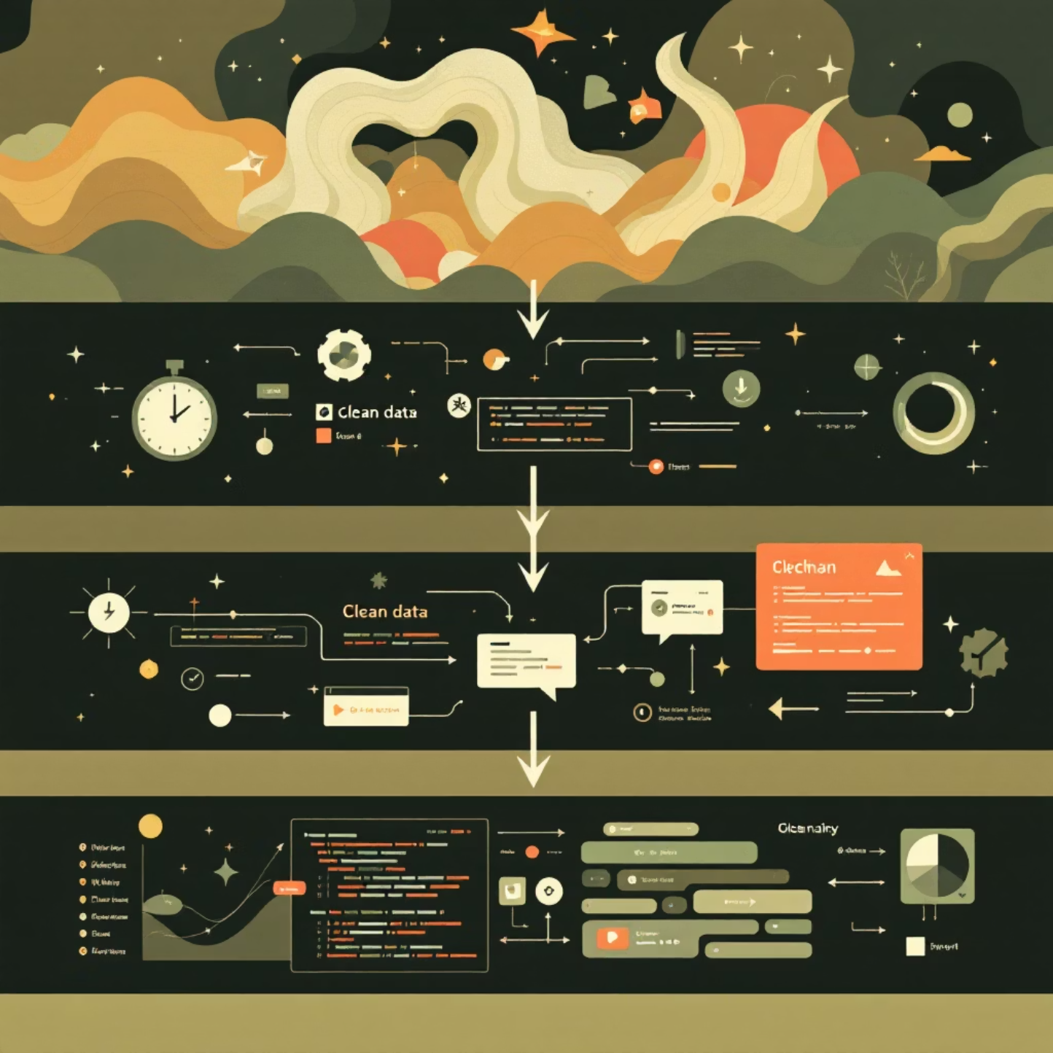
Data Cleaning & Transformation
Python & Jupyter Notebook
Anaconda distribution on macOS
Jupyter for cleaning & transformation
Libraries: pandas, numpy, sqlalchemy, psycopg2
PostgreSQL with Docker
Reproducible, isolated environment
SQLAlchemy for Python-PostgreSQL connection
DataFrames loaded directly
Key steps: handling missing values, correcting data types, creating derived columns (age_group), standardizing categorical values.

Slide 6
SQL Analysis in VS Code
Extensive analytical querying using Visual Studio Code with SQLTools.
1
2
3
Q1: Revenue by Gender
Q2: Discounted High Spenders
Q3: Top 5 Products by Rating
Female: $75,191, Male: $157,890
Gloves (3.86), Sandals (3.84), Boots (3.82), Hat (3.80), Skirt (3.78)
Customers using discounts but spending above average.
4
5
Q4: Avg. Spend by Shipping
Q5: Subscriber vs. Non-Subscriber
Standard: $58.46, Express: $60.48
Subscribers: $62,645 total revenue; Non-subscribers: $170,436 total revenue.

Slide 7
SQL Analysis: Advanced Queries
Q6: Products with Highest Discount Usage
1
Hat (50%), Sneakers (49.66%), Coat (49.07%), Sweater (48.17%), Pants (47.37%).
Q7: Customer Segmentation
2
Loyal (3116), New (83), Returning (701).
Q8: Top 3 Products per Category
3
Accessories: Jewelry, Sunglasses, Belt. Clothing: Blouse, Pants, Shirt. Footwear: Sandals, Shoes, Sneakers. Outerwear: Jacket, Coat.
Q9: Subscription Status of Repeat Buyers
4
No: 2518, Yes: 958.
Q10: Revenue by Age Group
5
Young Adult ($62,143), Middle-aged ($59,197), Adult ($55,978), Senior ($55,763).

Slide 8
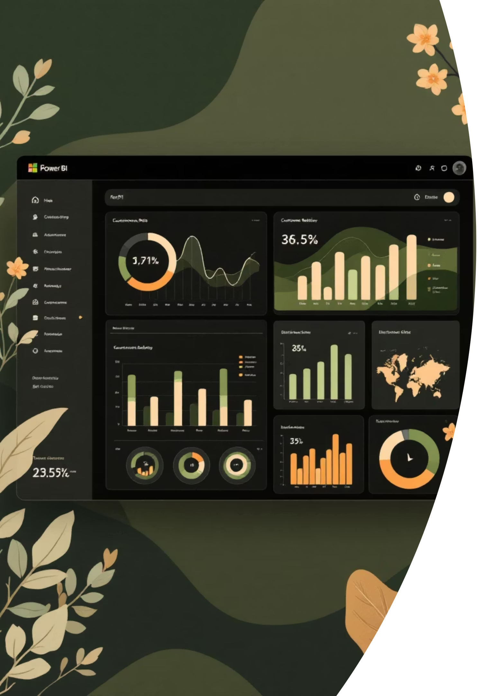
Power BI: Interactive Dashboard
Power BI Desktop on Windows 11 ARM VM (VMware Fusion) for visualization.
3.9K
$59.76
3.75
Customers
Avg. Purchase
Avg. Review

Slide 9


Key Insights & Data Pipeline
Key Insights
High-Level Pipeline Flow
Subscribed customers generate higher revenue.
Clothing dominates revenue and sales.
Raw Customer CSV
DB to Dashboard
Cleaning & Fe
Young Adults & Middle-aged contribute most revenue.
Discounts heavily used on specific products.
Faster shipping doesn't always mean higher spending.

Slide 10





Future Enhancements
Automate ETL
Using Apache Airflow.
Cloud Migration
PostgreSQL to AWS RDS / Azure Database.
Publish Dashboard
To Power BI Service.
Predictive Analytics
Forecasting with machine learning.
Access & Refresh
Implement role-based access and data refresh scheduling.

